Slide 1
Lightweight Noise Barrier and Quieter Pavement Studies on IH-30 in Dallas, Texas
Manuel Trevino
July 2016

Slide 2
Background
IH-30, near downtown Dallas, was expanded in early 2000s
Original Pavement: Transversely tined CRCP
Noise has been a problem ever since for adjacent neighborhood
IH-30 Reconstruction/Environmental Assessment in 2005
A proposed noise barrier did not meet FHWA cost effectiveness criterion

Slide 3
Background
Quieter pavements placed in 2006 and 2010
TxDOT pilot project for a light-weight noise barrier started in 2013

Slide 4
Background
1.2-mi section
Next to a residential neighborhood (Kessler Park)
Heavy commuter traffic and high number of trucks

Slide 5
Project Location

Slide 6
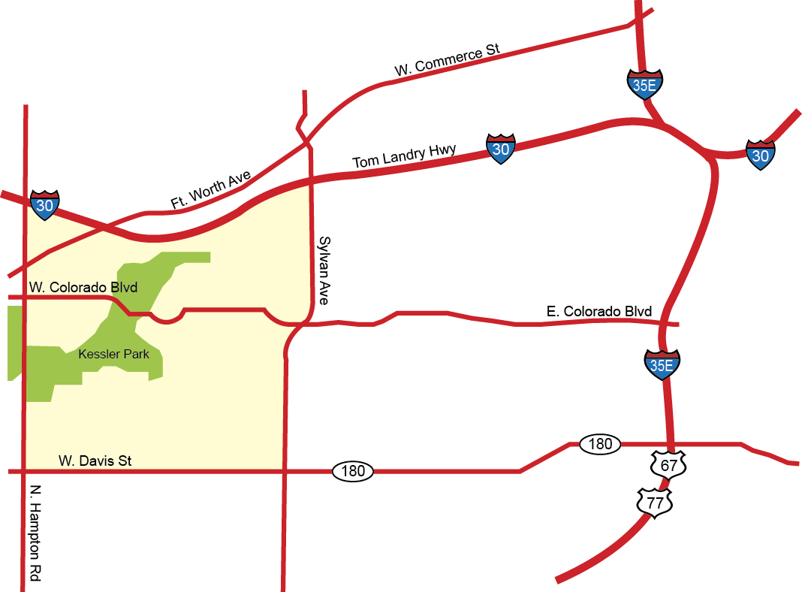
Project Location

Slide 7
IH-30 Truck Traffic

Slide 8
Kessler Park Neighborhood

Slide 9
Highway View from Residence

Slide 10
Quieter Pavements
Original pavement:
Transversely tined continuously reinforced concrete pavement (CRCP)
First overlay (2006)
1.5-in. thick
Open-graded asphalt (permeable friction course -PFC)
Easternmost segment
Constructed: May 2006
0.5-mi. long

Slide 11
Quieter Pavements
Second overlay (2010)
1-in. thick PFC
Adjacent to 2006 overlay, extending west
Constructed: summer 2010
3/4-mi long

Slide 12
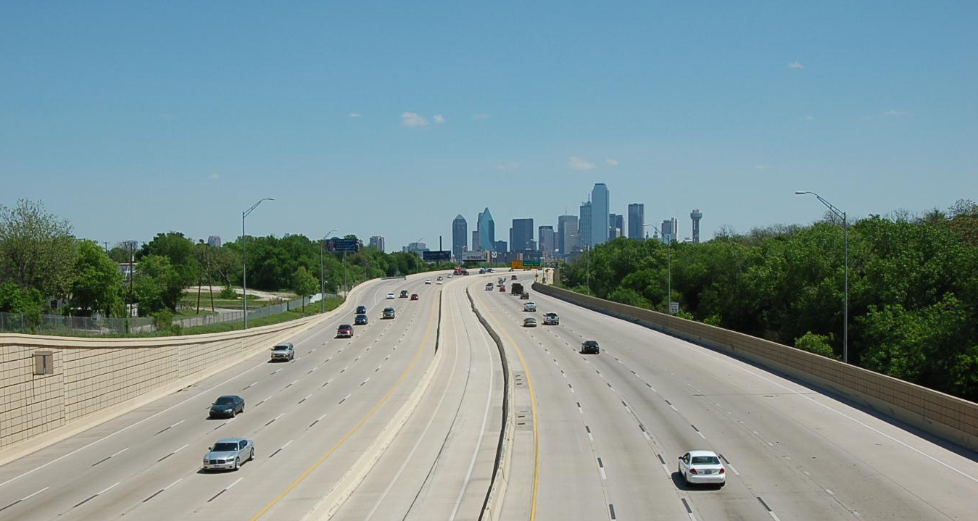
Tined CRCP
Photo: May 2006

Slide 13
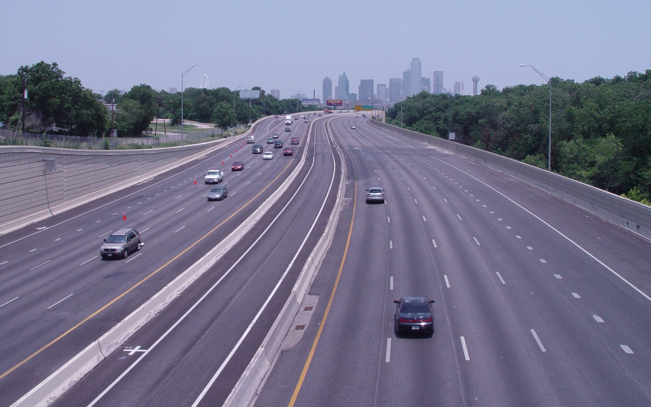
Open-Graded Pavement (PFC)
Photo: October 2010

Slide 14
PFC Overlays
2010 PFC Overlay
2006 PFC Overlay

Slide 15
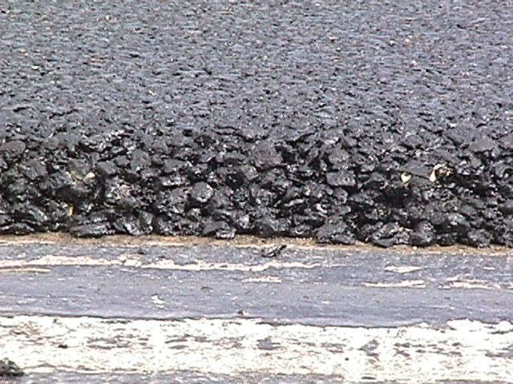
PFC - Quieter Pavements
High air-void content
Open-graded structure draws water off surface
Excellent performance in Texas, for safety as well as noise reduction

Slide 16
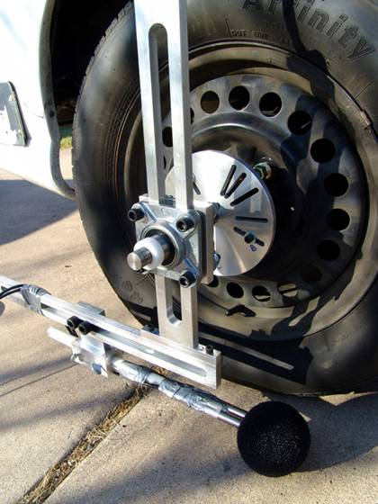
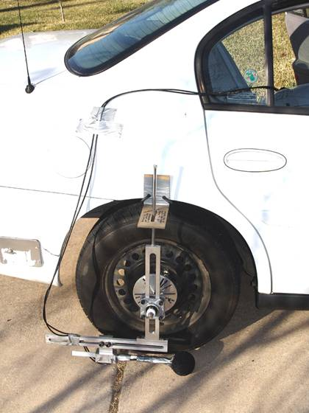
OBSI – Single Probe

Slide 17
OBSI Tests – Before vs. After (2006)
105
May 2006
104
Sept 2006
103
102
Overall Level (dBA)
CRCP
101
CRCP
100
CRCP
PFC
CRCP
99
PFC
PFC
PFC
98
WB1
WB2
EB1
EB2
WBCRCP
Section

Slide 18
OBSI Tests – Before vs. After (2006)
105
WB1 (CRCP)
100
WB2 (CRCP)
EB1 (CRCP)
WB1 (PFC)
WB2 (PFC)
95
EB1 (PFC)
EB2 (PFC)
WB CRCP
90
Overall Level (dBA)
85
80
75
70
65
500
630
800
1000
1250
1600
2000
2500
3150
4000
5000
1/3 Octave Band Center Frequency (Hz)

Slide 19
OBSI Tests – Before vs. After (2010)
112
110
108
106
Apr. 2010
104
CRCP
Overall Level (dBA)
Aug. 2010
102
CRCP
100
PFC
PFC
98
96
EB 2
Section
WB 2

Slide 20
IH-30 Noise Barrier Study
Noise continued to be a problem
2013, TxDOT: Conduct a feasibility study for a light-weight traffic noise wall
Selection of material types and vendors
Design
Inspection
Sound measurements

Slide 21
Noise Barrier Considerations
Barrier material needed to be light to avoid having to retrofit bridge structures
Noise barriers are normally not effective for receivers on a hillside overlooking the highway or for receivers at heights above the top of a noise barrier

Slide 22
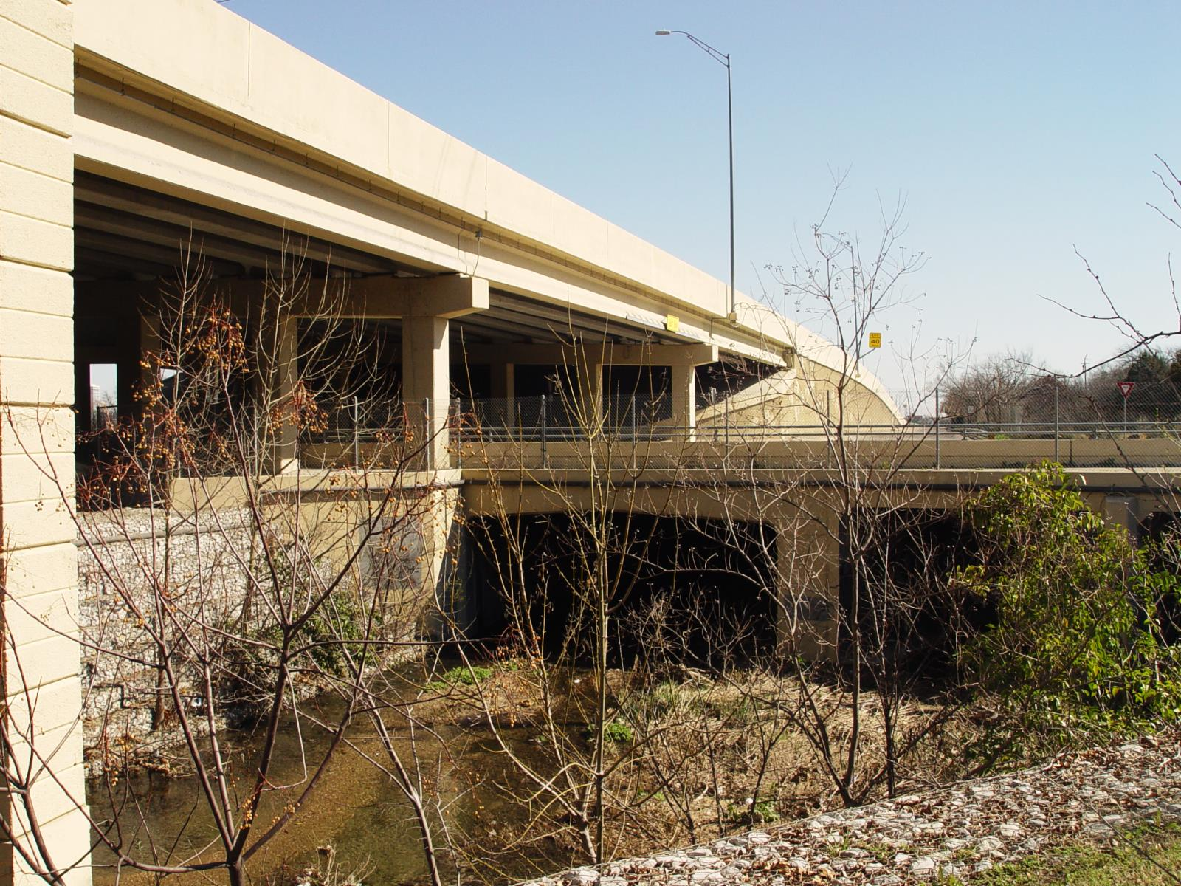
Elevated Highway Structure

Slide 23
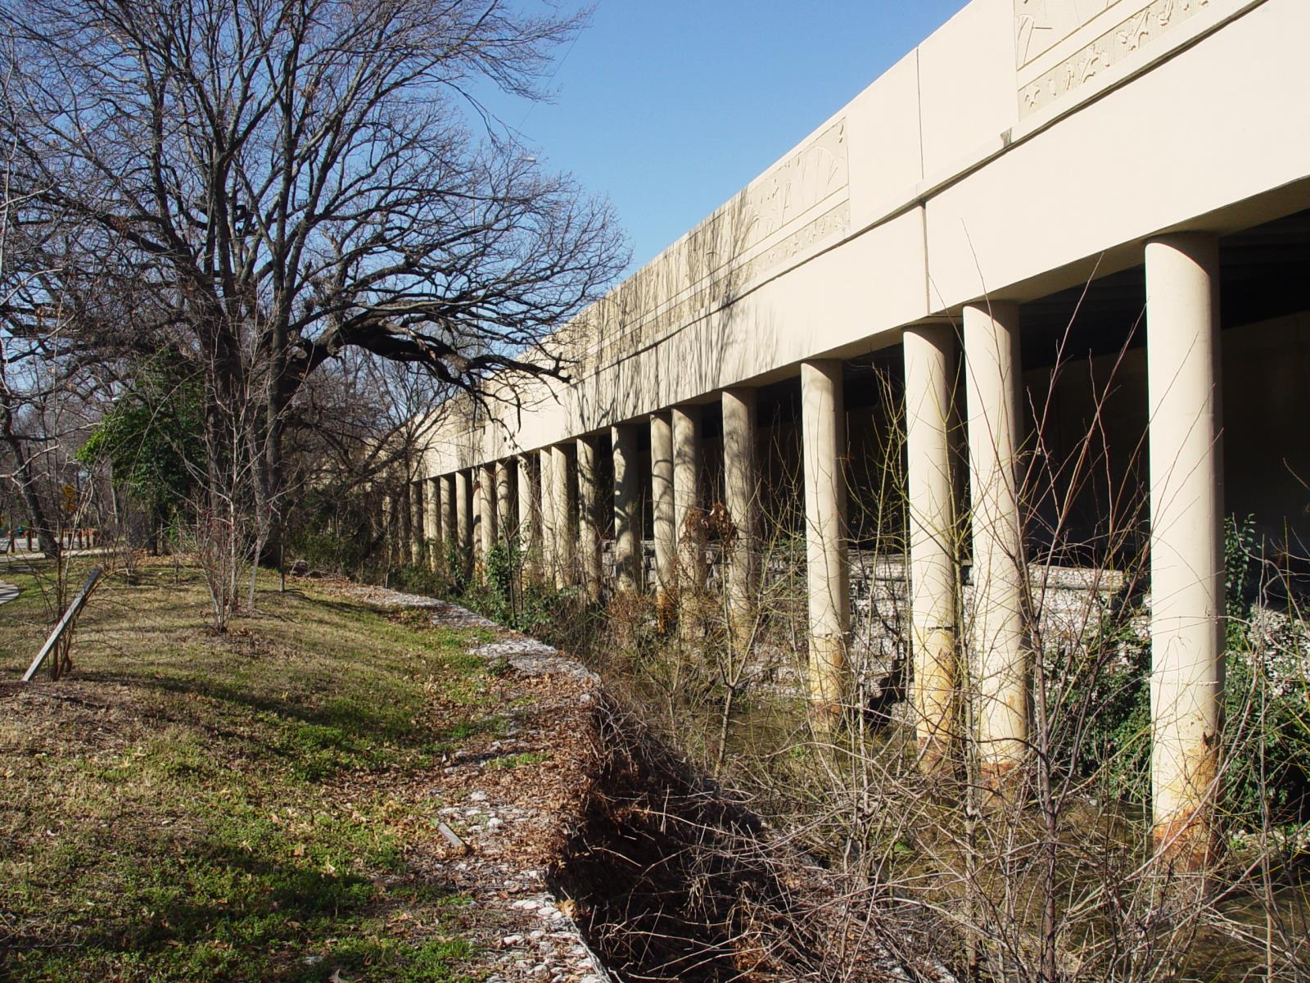
Elevated Highway Structure

Slide 24
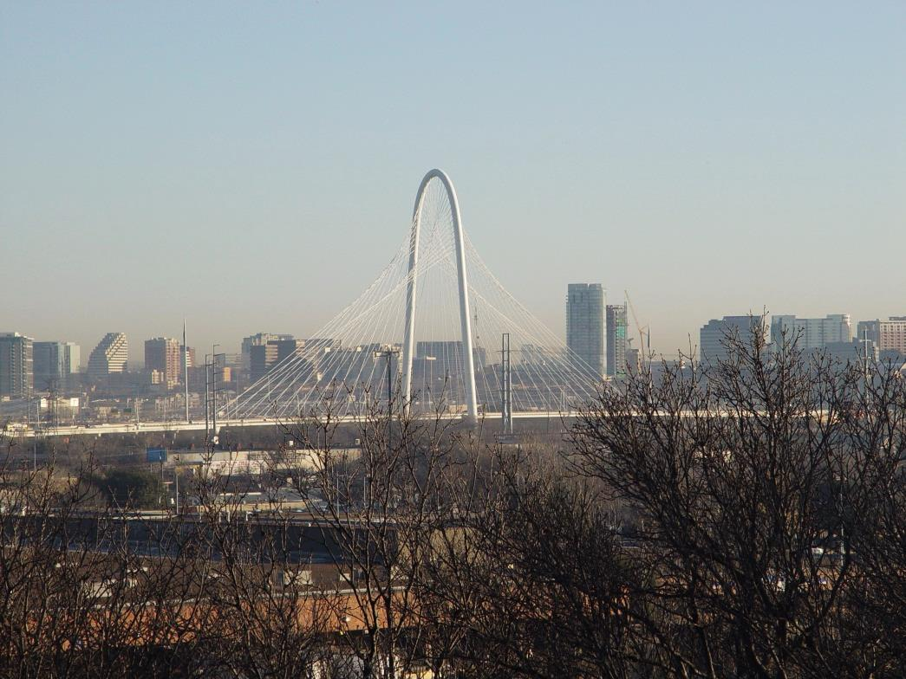
Scenic View from Residence

Slide 25
Noise Barrier Analysis & Design
Barrier analysis: existing 8-ft. wall, with additional height increments of 2-ft. up to 12 ft., on top of the existing wall.
Future traffic: 2035
A minimum of 8-ft. tall height was recommended to provide benefits to some receivers, and a 10-ft. wall was recommended to provide benefits for locations along the park

Slide 26
Noise Barrier Design & Costs
Transparent acrylic material
10-ft. panels above the existing 8-ft. barrier
15-mm thick
23,950 sq. ft.
Material cost $32/sq. ft.
Project cost $860,000

Slide 27
Transparent Walls
Aesthetically pleasing
Preserve views and sunlight
Could relieve the feeling of enclosure
Could attract graffiti
Graffiti is easier to clean
STC =32 dB
Lightweight

Slide 28
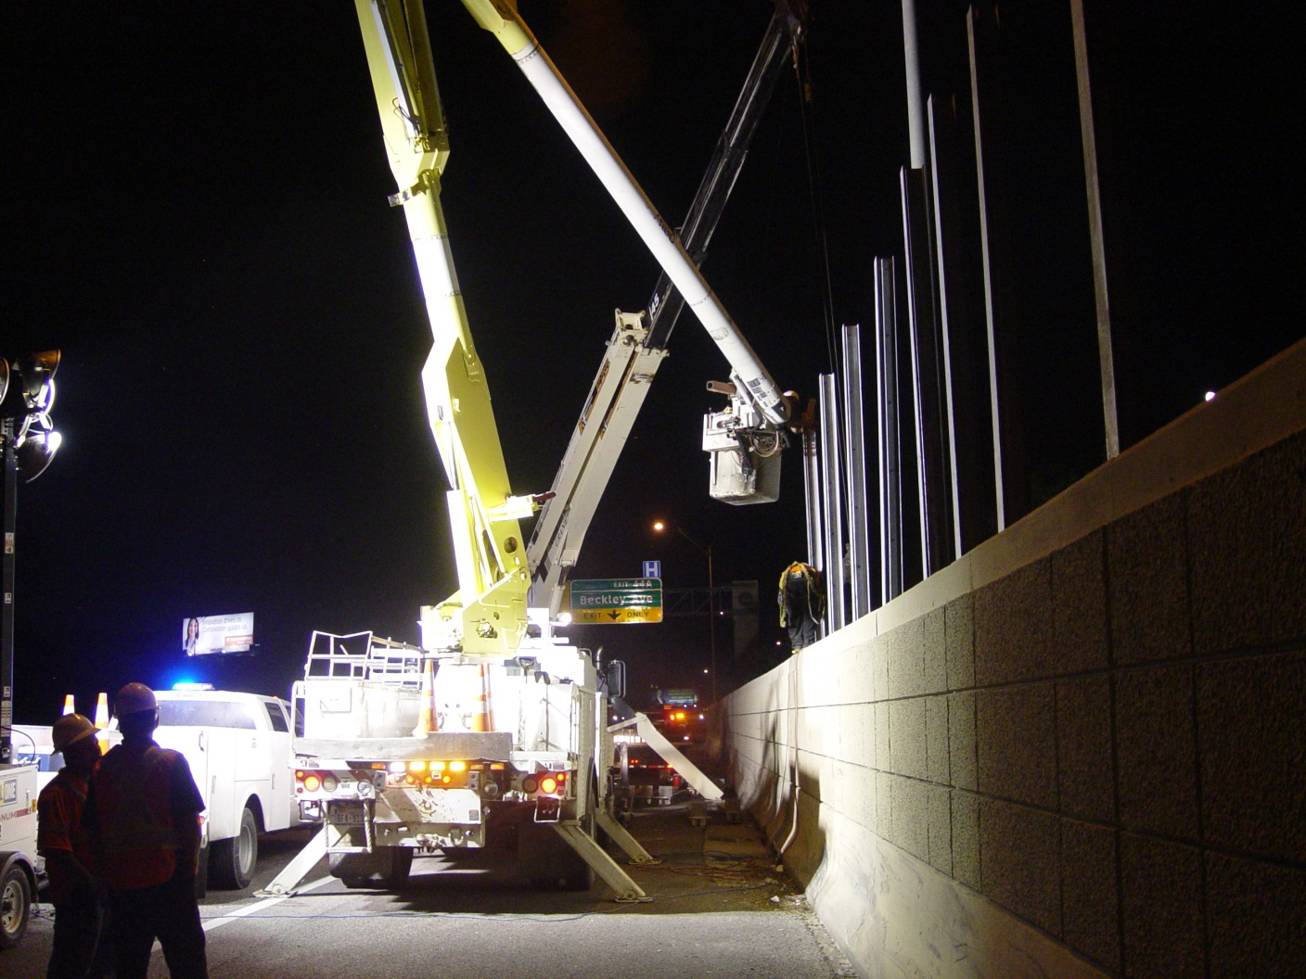
Noise Barrier Installation
Photos from September 23-24, 2013

Slide 29
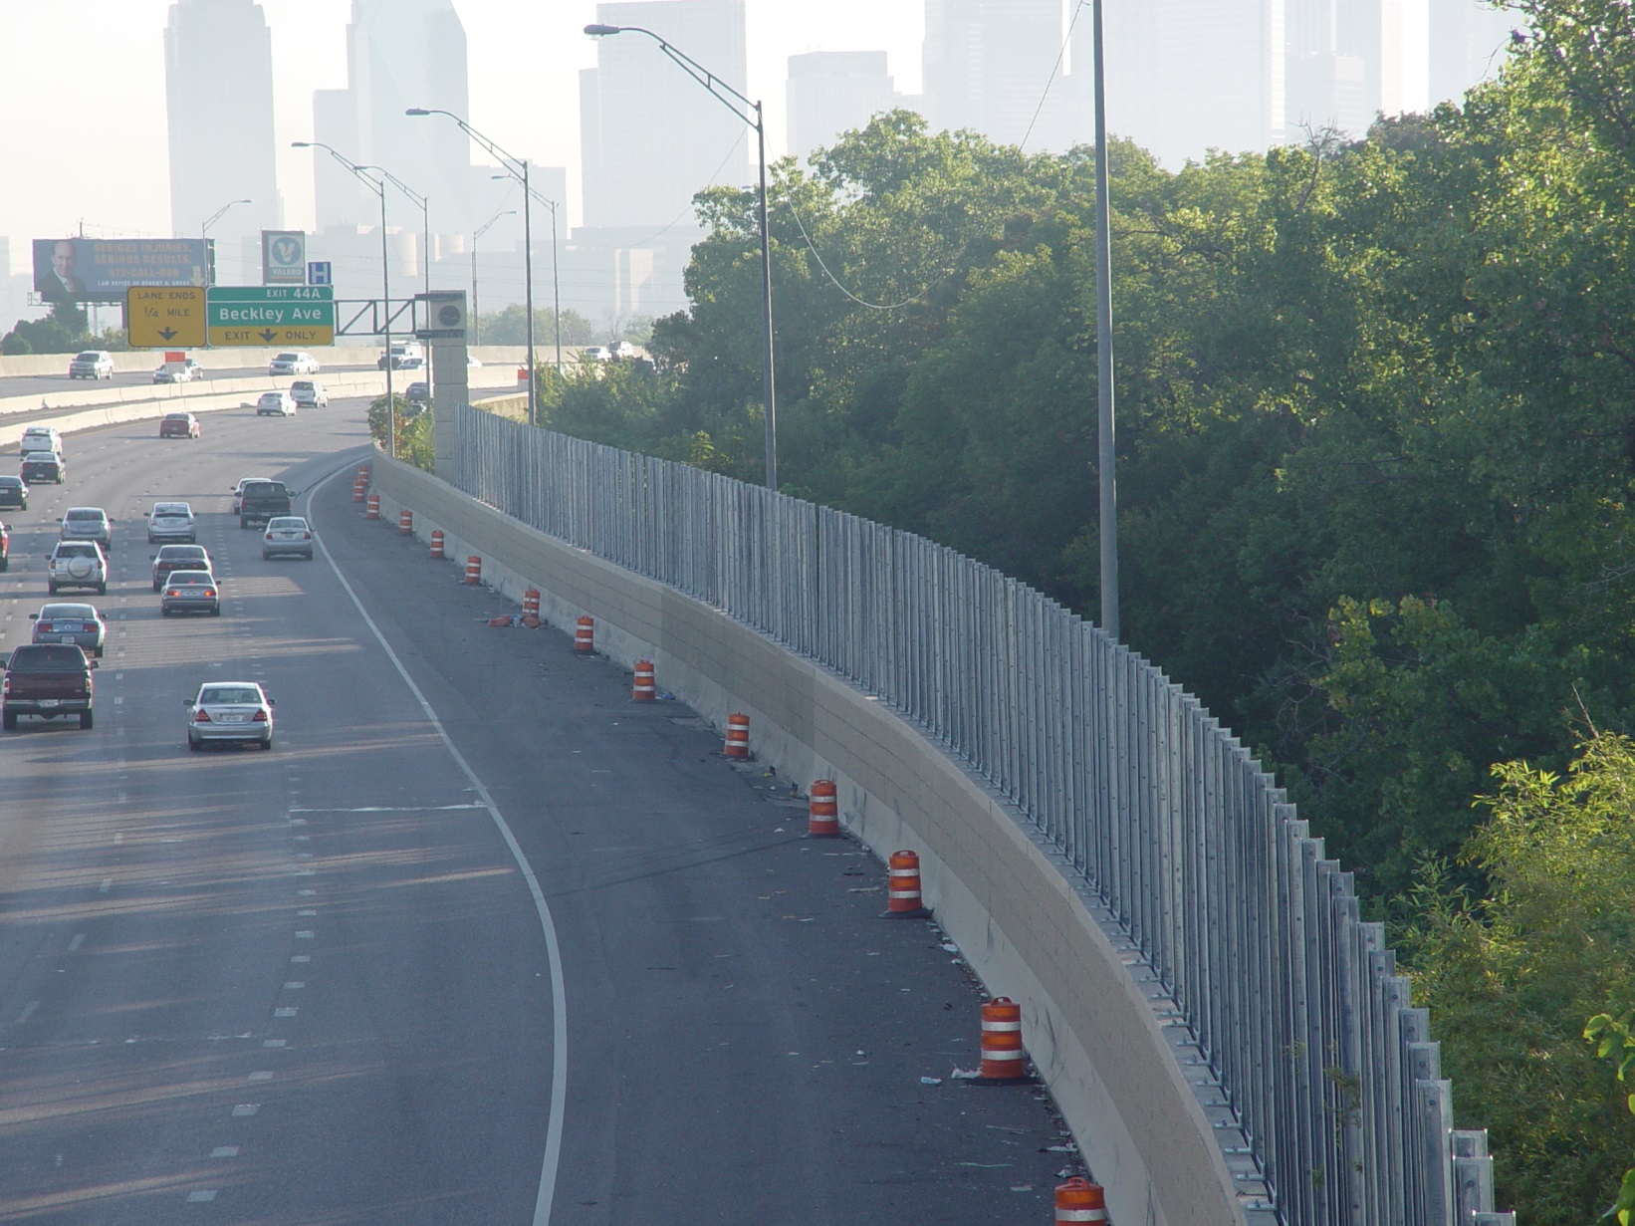
Noise Barrier Installation
Photos from September 23-24, 2013

Slide 30
Noise Barrier Finished

Slide 31
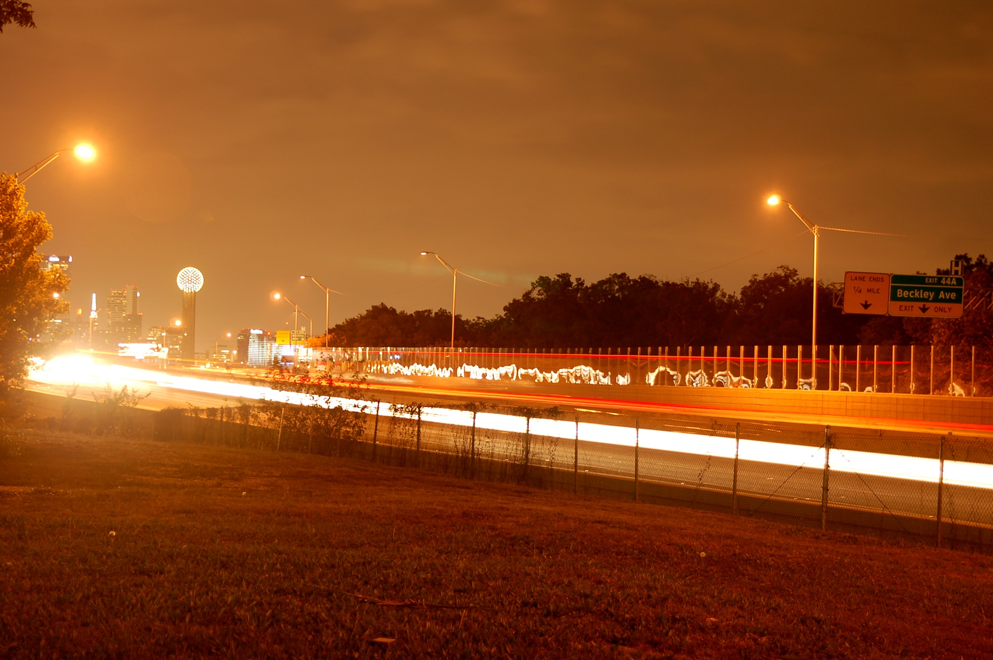

Slide 32
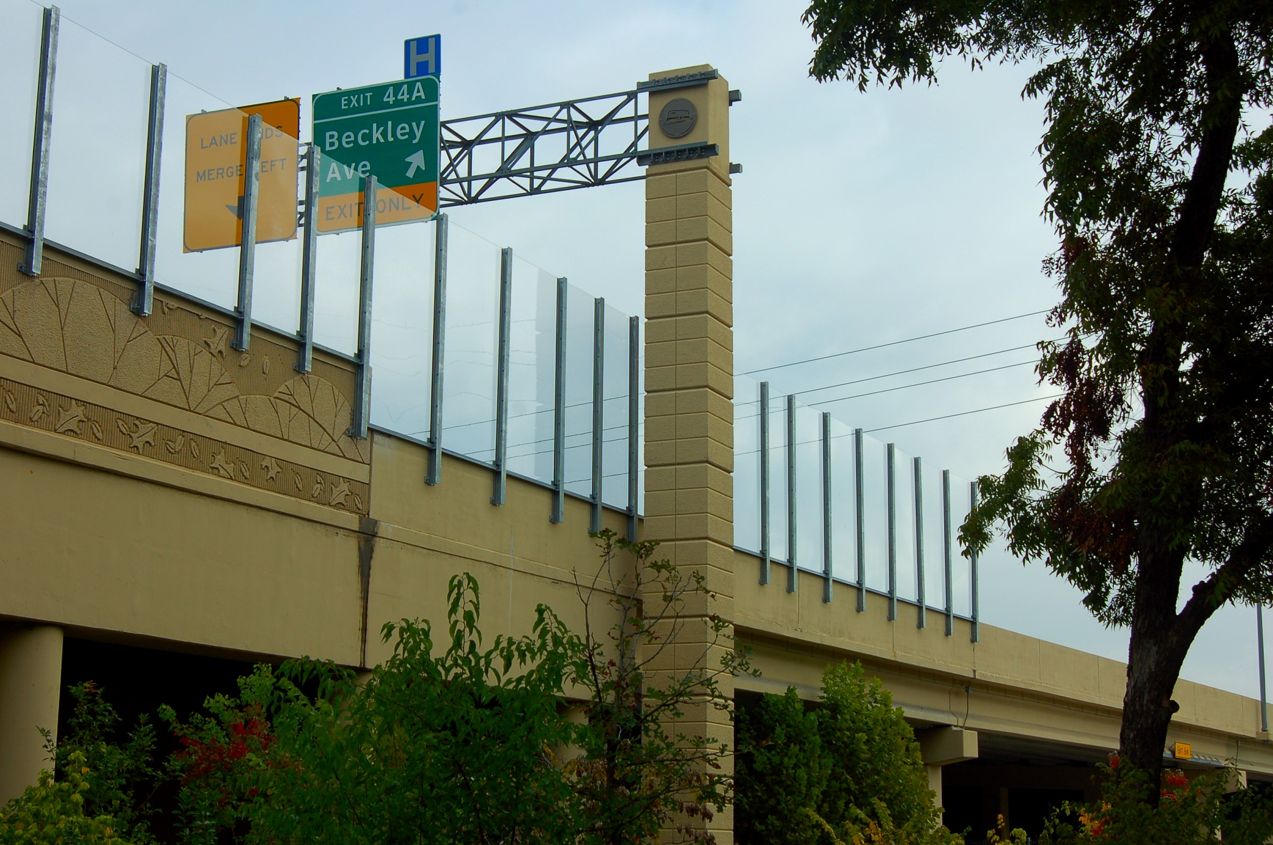

Slide 33
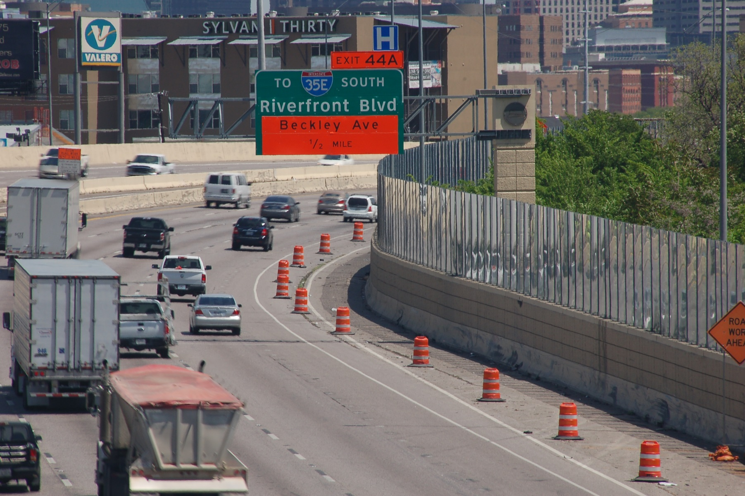
IH-30 Noise Wall

Slide 34
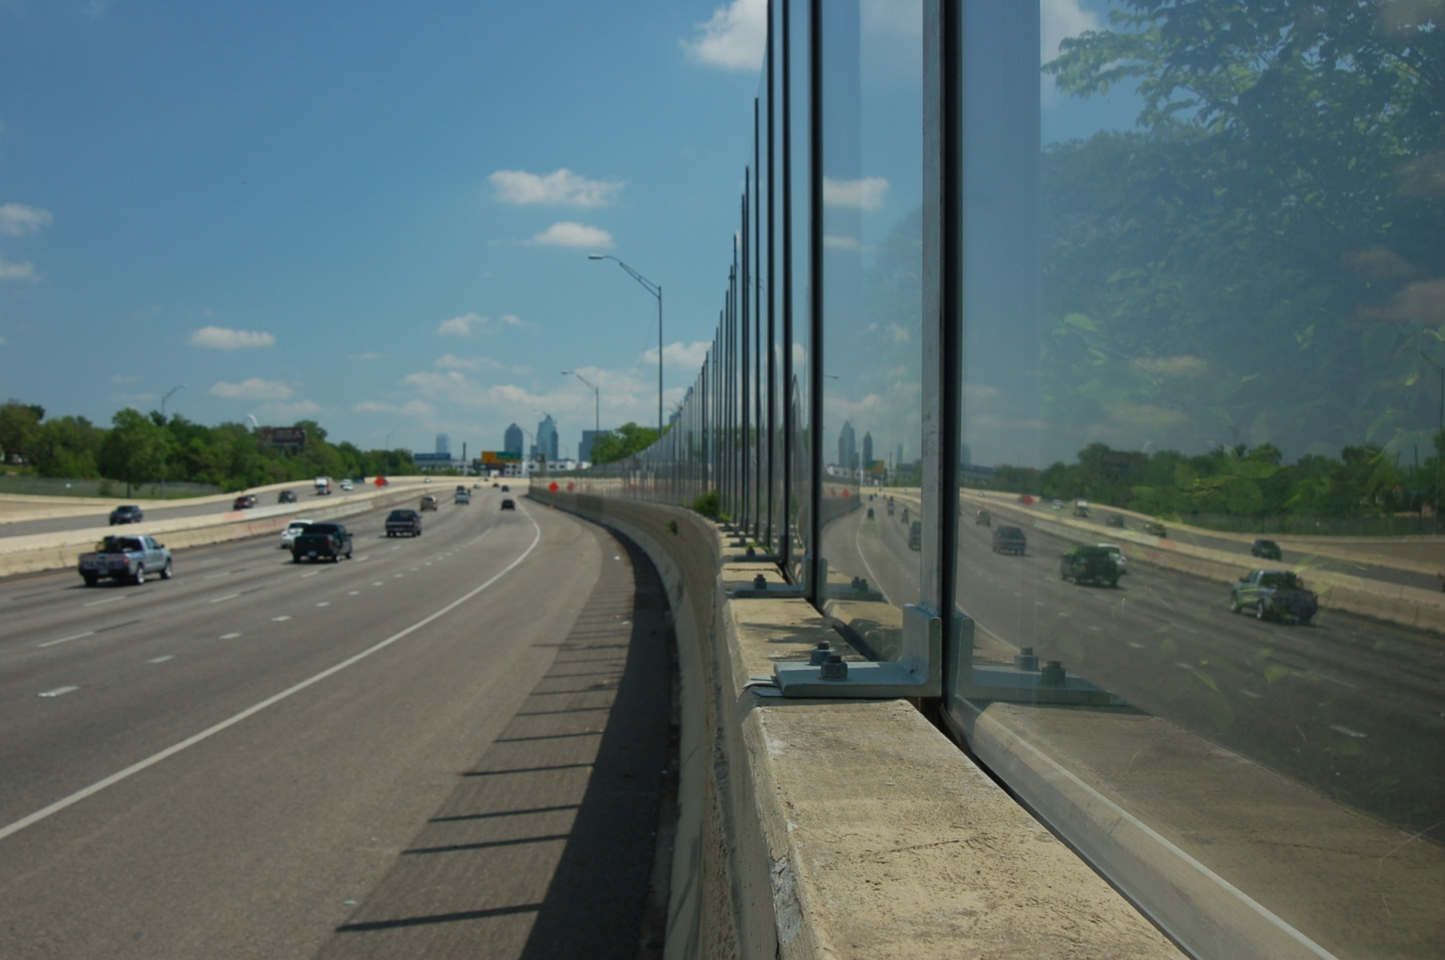
IH-30 Noise Wall

Slide 35
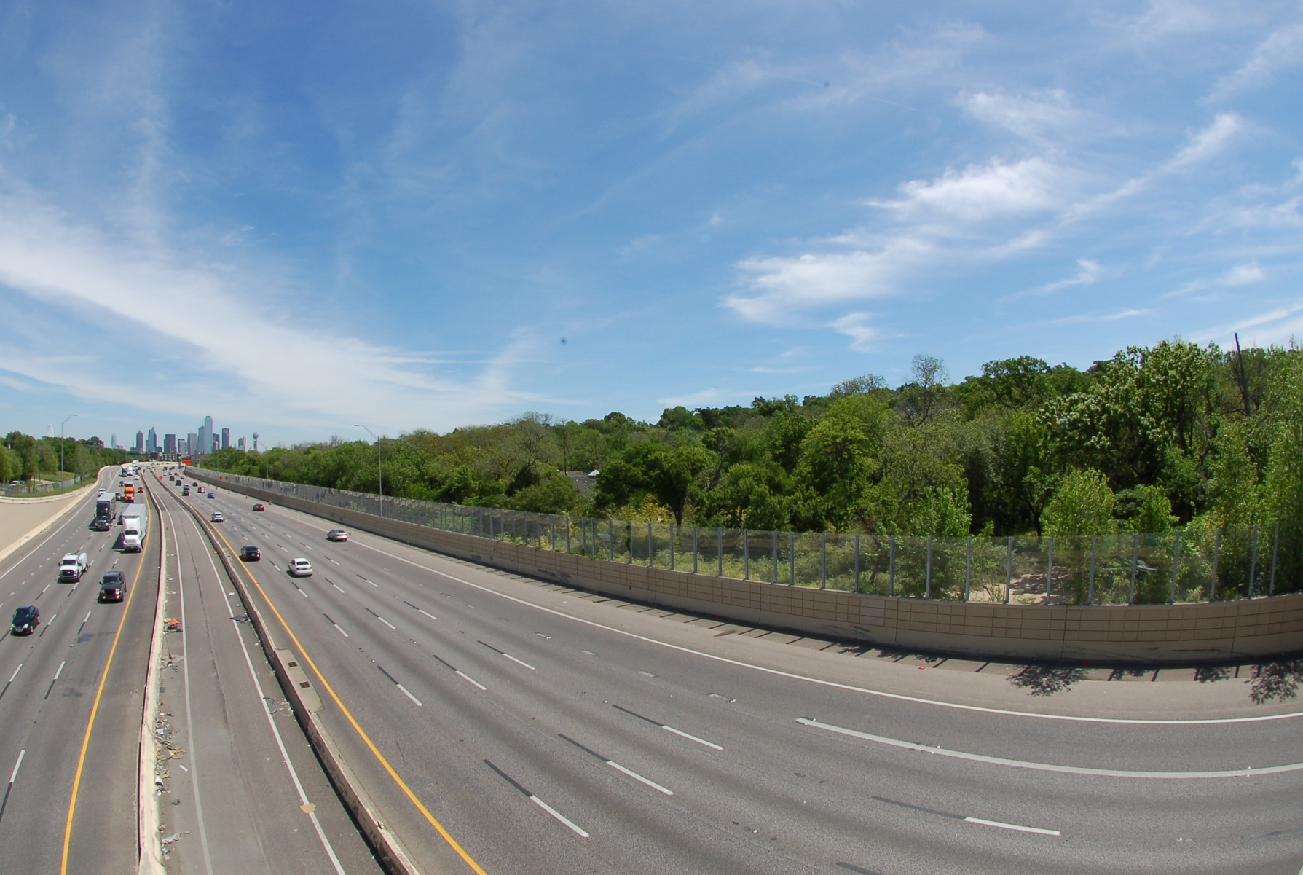
IH-30 Noise Wall

Slide 36
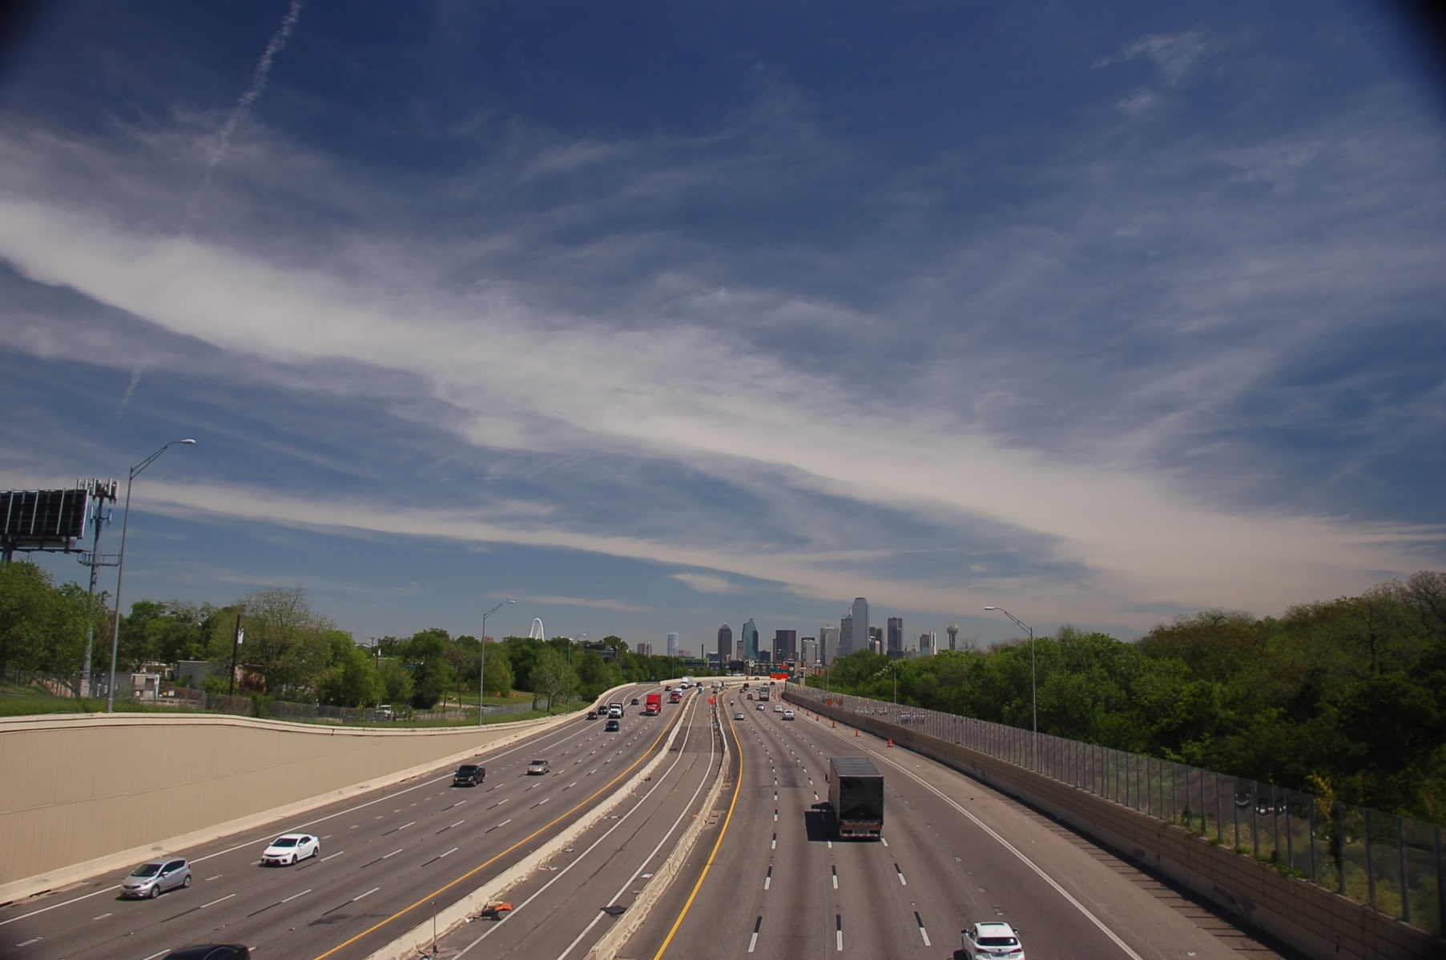
IH-30 Noise Wall

Slide 37
Noise Measurement Procedure
SPL measurements taken before and after barrier installation
Four residential locations and a park location
Morning, afternoon and evening tests
Measurements taken approximately every month
In conjunction with a portable weather station

Slide 38
Kessler Park Neighborhood
Noise Barrier
B
C
F
D
E

Slide 39
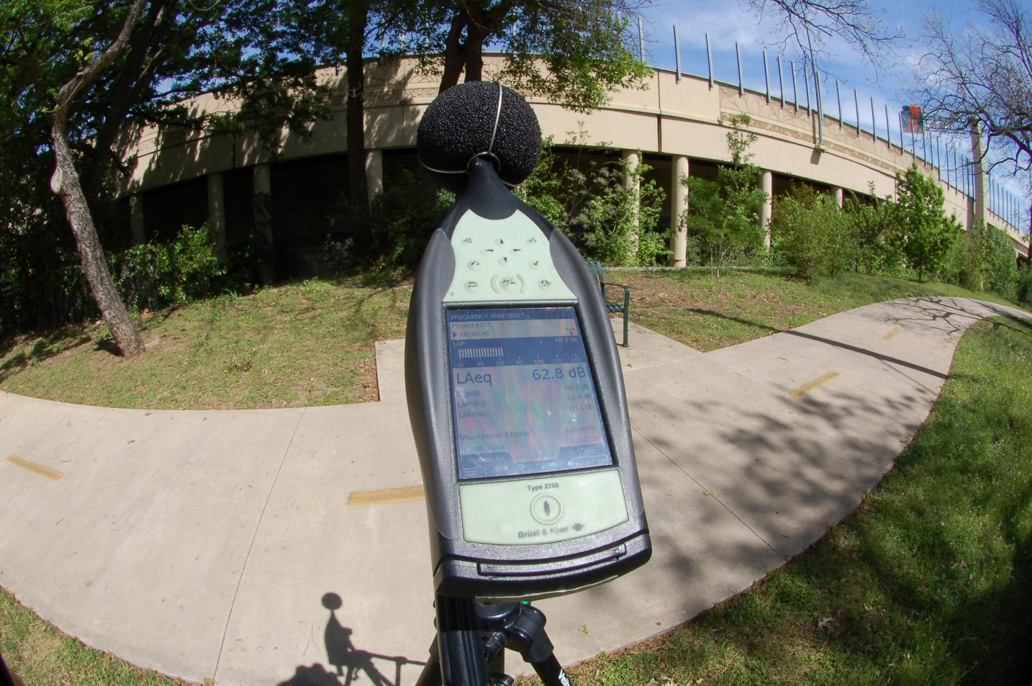
Noise Measurements

Slide 40
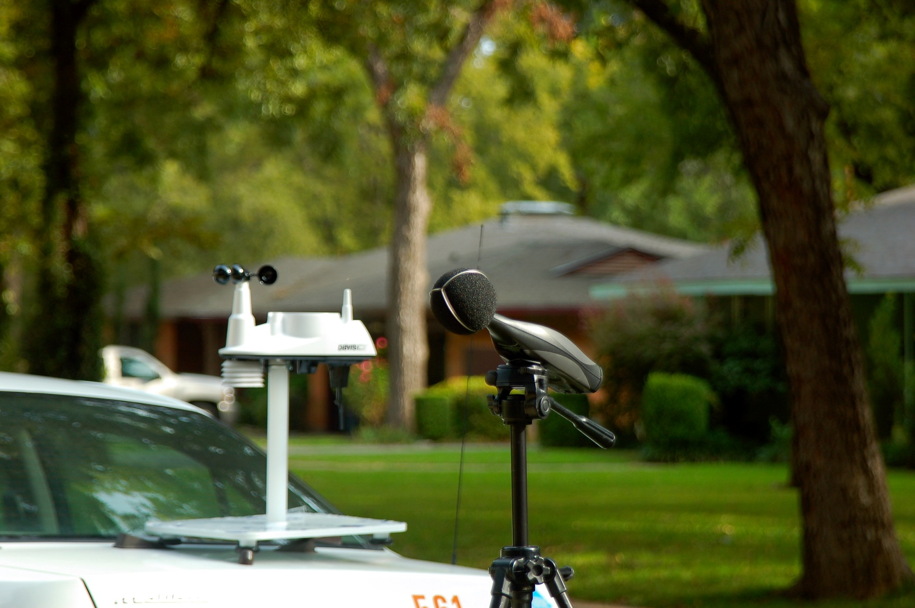
Noise Measurements

Slide 41
Noise Measurement Results
130 measurements before the wall was installed (May 2013 to Sept. 2013)
426 measurements after wall was installed (Oct. 2013 to May 2016)
Average level before wall: 58.2 dBA
Average level after wall: 56.8 dBA

Slide 42
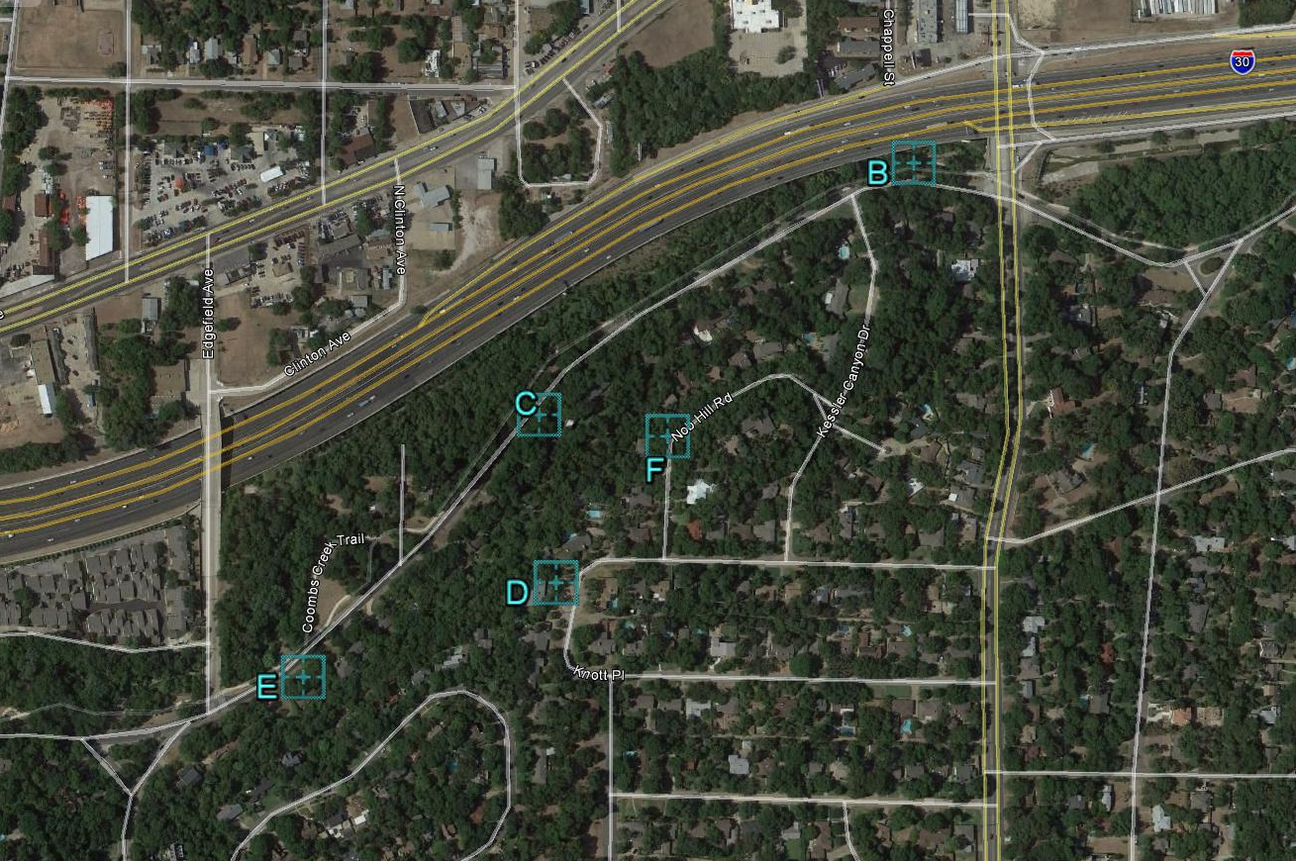
Noise Measurements: Before vs. After
Until January 2015
63.0
61.5
60.3
57.3
56.5
53.9
54.1
52.4
Noise Level (dBA)
Before Wall Avg.
After Wall Avg.
57.0
56.3

Slide 43
Noise Measurements: Before vs. After
Until May 2016
63.0
61.9
60.3
57.7
56.5
54.4
54.1
52.6
Noise Level (dBA)
Before Wall Avg.
After Wall Avg.
57.0
57.0

Slide 44
Noise Measurements by Date
Before Noise Wall
After Noise Wall

Slide 45
Noise Measurements
Noise vs. Temperature

Slide 46
Noise Measurements
Noise vs. Temperature

Slide 47
Noise Measurements
Noise vs. Wind Speed

Slide 48
Noise Measurements
Noise vs. Wind Speed

Slide 49
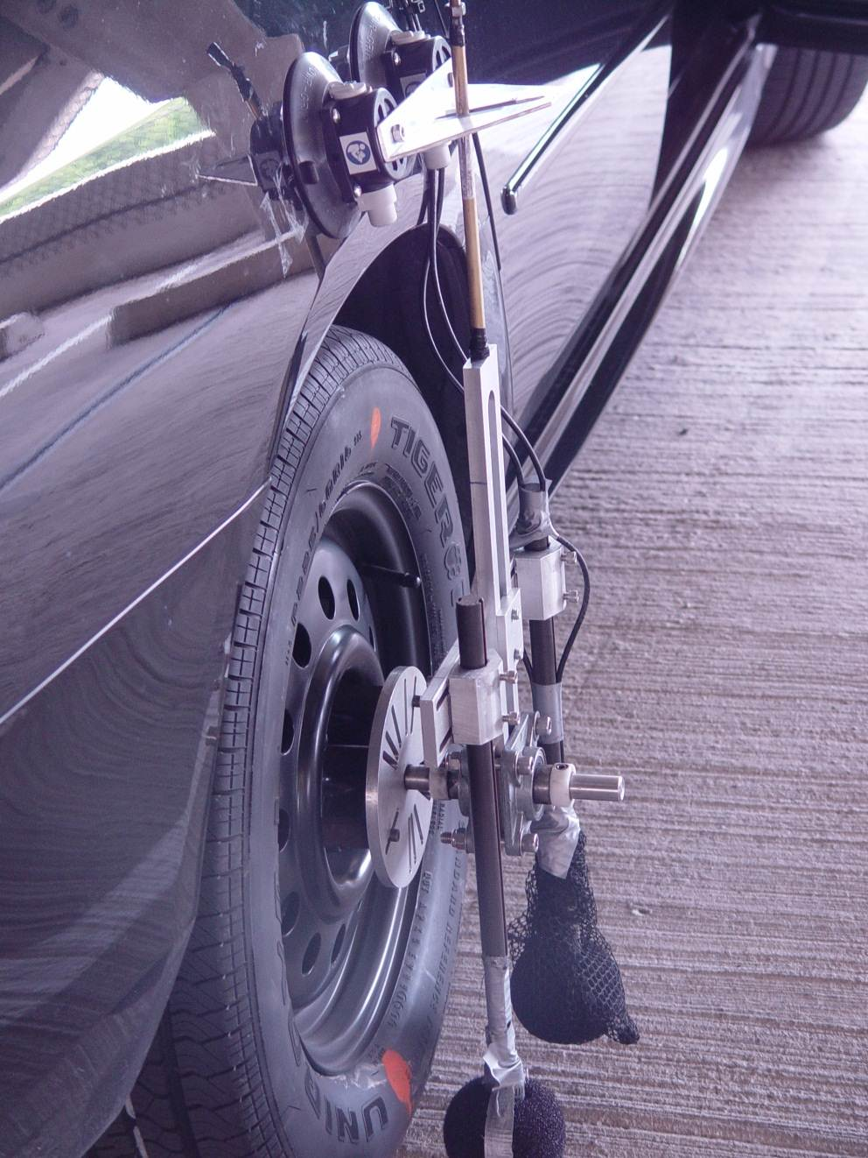
On-Board Sound Intensity

Slide 50
OBSI Tests – (Sept. 2014)

Slide 51
OBSI Tests – (May 2016)

Slide 52
OBSI Tests – 2014 vs.2016

Slide 53
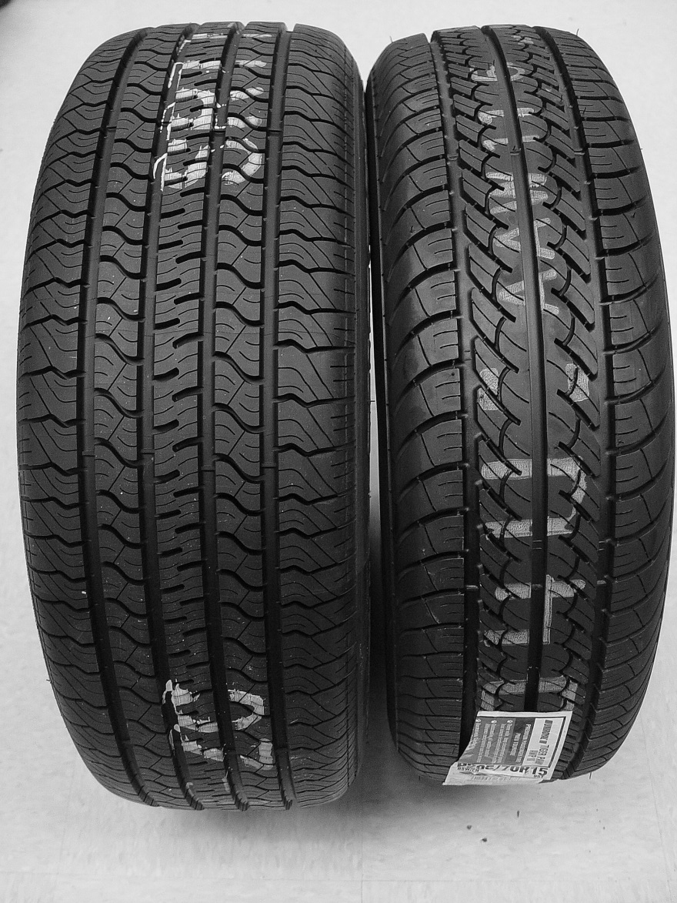
SRTT vs. Uniroyal Tiger Paw AWP

Slide 54
PFC in 2010

Slide 55
PFC in 2016

Slide 56
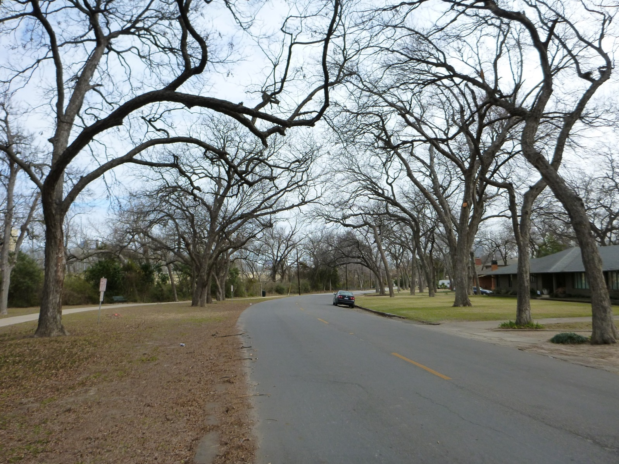
Foliage in Winter

Slide 57
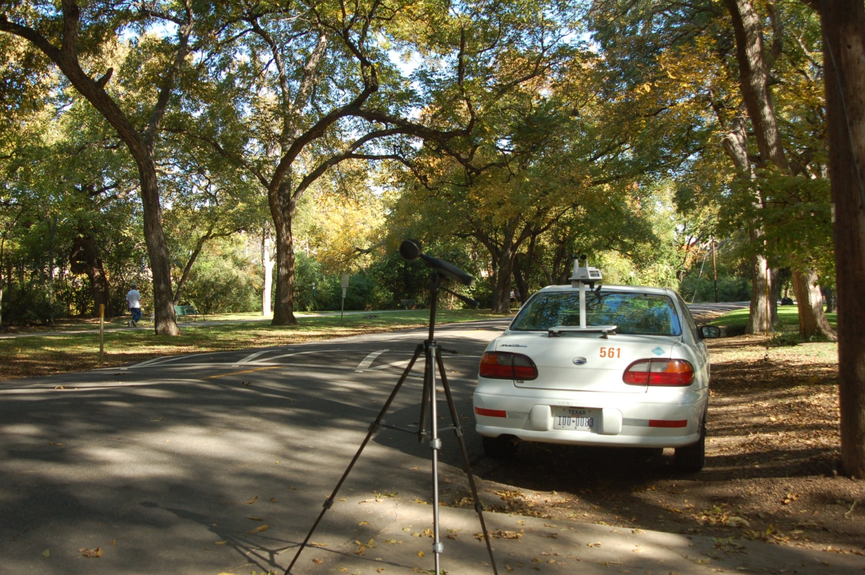
Foliage in Summer

Slide 58
Conclusions
Significant noise reduction (2-3 dBA) by 2006 PFC
2010 PFC not as absorptive as 2006 PFC originally was
PFC overlays getting louder (clogging, compaction)
Thicker overlays are generally more absorptive
Both overlays have provided important reductions in noise levels, even though these overlays are not among the quieter PFCs

Slide 59
Conclusions
Noise reduction with wall varied from 0.7 to 3.0 dBA (until Jan. 2015) and from 0.0 to 2.6 dBA (until May 2016)
Location with more benefit is close to highway and at a lower elevation (C)
Sound wall provided significant noise reduction in the few months following its completion
Noise levels appear to get higher in the colder months
Cold temperatures are correlated to higher tire-pavement noise generation (1 dBA per 10°C)

Slide 60
Conclusions
Other weather variables appear to have no significant influence
Foliage might have some influence (no foliage-higher noise). Foliage diffracts and absorb sound
Changes of pavements’ performance impacts wall apparent effectiveness
Neighbors are very satisfied with the wall

Slide 61
Acknowledgements
George Reeves, TxDOT
Mark McIlheran, Armtec, Evonik Acrylite
TxDOT, Dallas District

Slide 62
